Slide 1



ProductPicker
Five Fools:
Trần Nguyễn Ngọc Bảo
Nguyễn Trí Dũng
Nguyễn Minh Hiếu
Võ Nguyễn Tấn Tài
Lê Đức Anh Việt

Slide 2
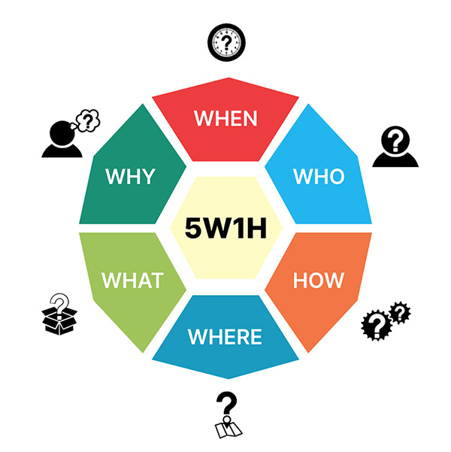
A. Creative thinking method

Slide 3


1. What is ProductPicker extension?
This is an extension that pops up in the chrome extension store
Help you find information about an item you came across and want to find out
Integrating AI technology to increase the ability to serve users

Slide 4


2. The reason for choosing the topic
After watching videos on the Internet, I see that there are products like clothes that I want to buy, but when I search, it is difficult to find the product I want to buy. So we wanted to choose this topic to make it easier to find products

Slide 5

3.
-What platform does this application/extension run on?
Platform: Windows, MacOS.
-When did the development of the application/extension start?
Start of development: The application is started development in January 2022.

Slide 6

-When is the expected launch of the application/extension?
Expected launch: The application is expected to be launched in July 2022.
-Who is the developer?
Developer: Our team.

Slide 7
4. How does this application works
This app/extension works based on A.I combined with image search engine. From there we will develop it so that it can find products that exist through each frame of a video. Then, it will bring up a list of the products that are currently being sold in the market, along with the suppliers of that product, and sorted by the reputation of the items (according to 5-star rating scale).

Slide 8
B. The Model of Market Opportunity
After discussion, we agreed that our model is alertness model
It is combined by two models that are competition model and innovation model
Based on the experiences of watching videos on the internet, we found an opportunity to create a new technology service that improves the convenience of buying and selling through videos.

Slide 9

C. The strategy of marketing
Customers: Who has a habit watch Video online.
To create video to introduce our Extension through the social media like Facebook , Youtube, Tiktok...
Create a website landing page to increase the appearance of the application in the internet. This website will show some function of this extension to user.
Give some point to the user who reffer someone to this app. The point will be used to unlock Premium function.
Discount for the user who invite many people to use this app. This discount can be decrease the price of product the user want to buy.
Also we will transfer this extension to App Mobile. Release this on the Google Play and AppStore. This direction of development can help our reach more user.

Slide 10

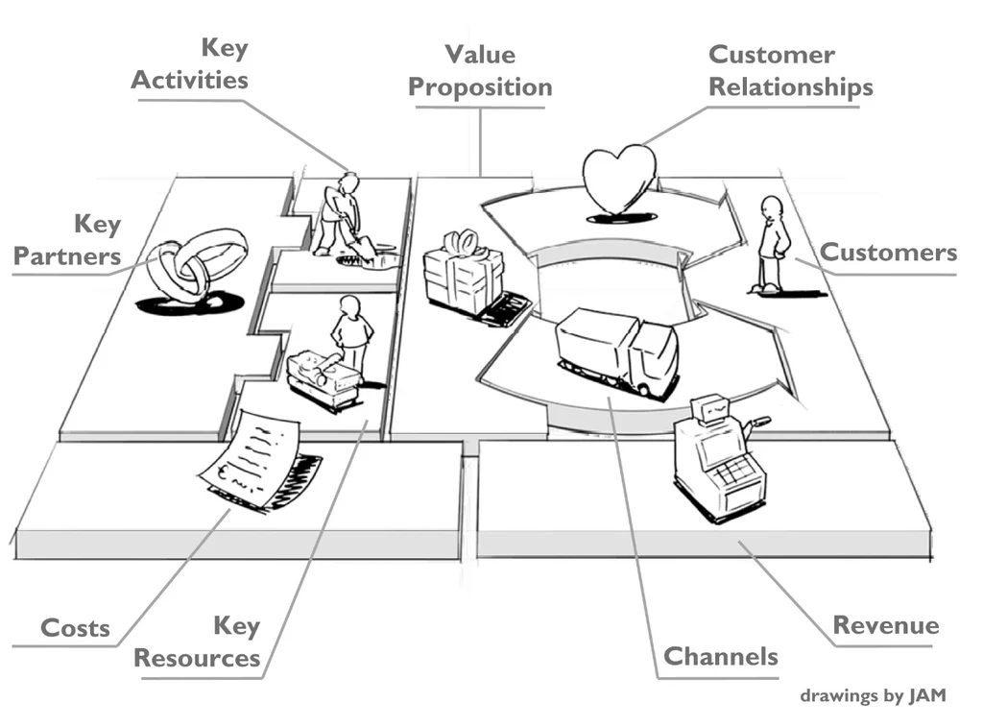
D. Bussiness Model Canvas
Key partners
Key activities
Key resources
Value proposition
Customer relationships
Customer segments
Revenue streams
Channels
Cost structure

Slide 11
1. Key partners:
Service Provider: Chrome browser/ Chrome web store, Google Play store, App store.
2. Key activities:
Develop and update extensions to meet user needs.
Check and fix errors in extension.
Optimize the performance and security of the extension.
Provide support and user interaction, including answering questions and handling technical issues.
3. Key resources:
Developer: Provides the expertise and knowledge to develop and maintain extensions.
Servers and infrastructure: To host and distribute extensions, provide infrastructure to support extension downloads and updates.
Support team: Support team to address user questions, support requests, and bug fixes.

Slide 12
4. Value proposition:
Provides additional features and customization for the Google Chrome browser.
Enhance the user experience by providing useful tools, functions or information.
Improved performance and convenience in web browsing.
5. Customer relationships:
Create a two-way communication environment with users through support, feedback, and interaction channels.
Provide regular updates and bug fixes to maintain relationships with users.
Respond quickly and efficiently to support requests and feedback from users.

Slide 13
6. Customer segments:
Users of the Google Chrome browser have the need to customize and extend the browser's features.
Users are interested in saving time searching for products and purchasing experience.
Businesses wishing to promote their products through extension
7. Revenue streams:
Charges from integrating ads or affiliate programs into the extension.
Offer a free version of the extension to attract users and then generate revenue from enhanced versions or additional features.
In the final stage, income from selling technology/extensions to businesses.

Slide 14
8. Channels
Google Chrome Web Store: Is the main platform for distributing and promoting extensions. Users can search, download and install extensions directly from the Web Store.
Personal Websites and Blogs: We can promote the extension through their website and blog, providing detailed information, instructions, and links to download the extension.
Social networks and online communities: Promote the extension through online communities, specialized forums, user groups, and social networks to attract attention and increase user community growth.

Slide 15
9. Cost structure:
Development and Upgrade: The costs associated with developing, testing, and upgrading the extension.
User support and interaction: Provide support to users, including answering questions, handling technical issues, and providing user guides. Costs associated with maintaining and operating the support service.
Management and maintenance: Update and fix bugs for extensions to ensure stable operation and compliance with Google Chrome regulations and changes. This cost includes testing and verifying the compatibility, security, and performance of the extension.
Affiliate and Advertising Fees: In the case of advertising integrations or affiliate programs, there may be costs associated with contracting, commission payments, and advertising management.
Technology infrastructure: To maintain the distribution environment, download and update extensions, there may be costs associated with servers, storage, bandwidth, and other technologies.

Slide 16


E. Finance
Sources of finance capital
Expenses, revenues, income

Slide 17
1. Sources of finance capital
Debt Financing
- Commercial banks
- Peer to peer lending (P2P)
Equity Financing
- Founding members
- Family and friends
- Angel investors

Slide 18
2. Expenses, revenues, income
Expenses:
the cost of maintenance
the cost of salary
Revenues:
We will sign contracts with sales companies, advertising companies to put their products on this extension.
When customers click to buy through our extension, we get a discount on a part of the product's selling price

Slide 19

Thank you for your time!

